Slide 1

Topic- Text Pattern Matching Tool
Tripti Vishwakarma Colorado State University Global Course Code CSC506 -1 Dr. Dong Nguyen Jan 12, 2025
Notes:
Introduction
In the realm of data analysis and information retrieval, efficient text searching is crucial. The Text Pattern Matcher tool leverages the Knuth-Morris-Pratt (KMP) and Rabin-Karp algorithms to fulfill this need. This paper explores the purpose of the tool, the challenges faced during its development, the skills acquired and provides a detailed analysis of the empirical data to identify time and space complexity trends. It also discusses optimizations implemented to improve algorithm performance

Slide 2
Project Goals
1. Implement a Text Pattern Matcher using KMP or Rabin-Karp.
2. Enable accurate pattern search and visualization.
3. Compare algorithm efficiency for varying inputs
Notes:
Project Goals
The goal of this project was to implement a Text Pattern Matcher using either the Knuth-Morris-Pratt (KMP) or Rabin-Karp algorithm. The application needed to:
Accurately search for specific patterns in text files.
Highlight the matched patterns within the text for better visualization.
Compare the efficiency of the algorithms for varying pattern lengths and input sizes.
By achieving these objectives, the project aimed to provide insights into the practical applications and performance trade-offs between the KMP and Rabin-Karp algorithms, which are widely used in string matching tasks.

Slide 3
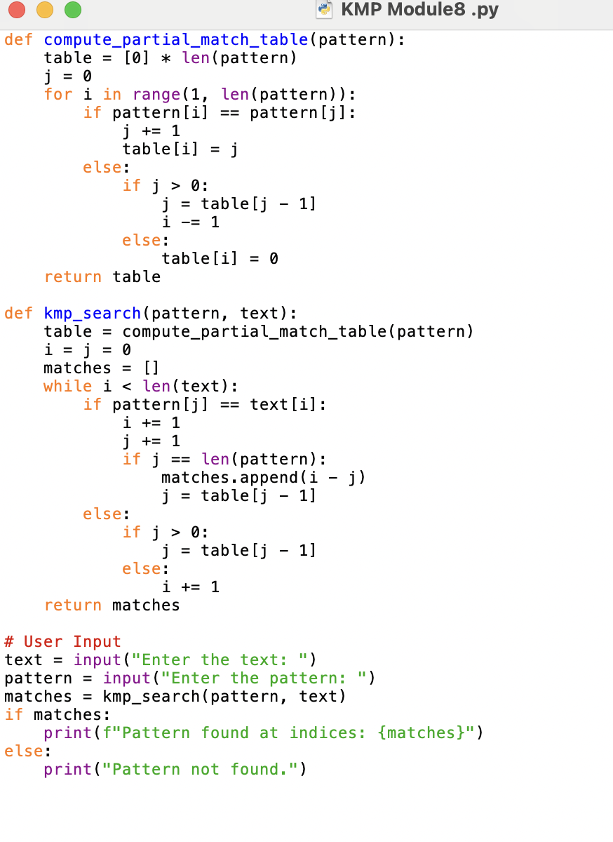
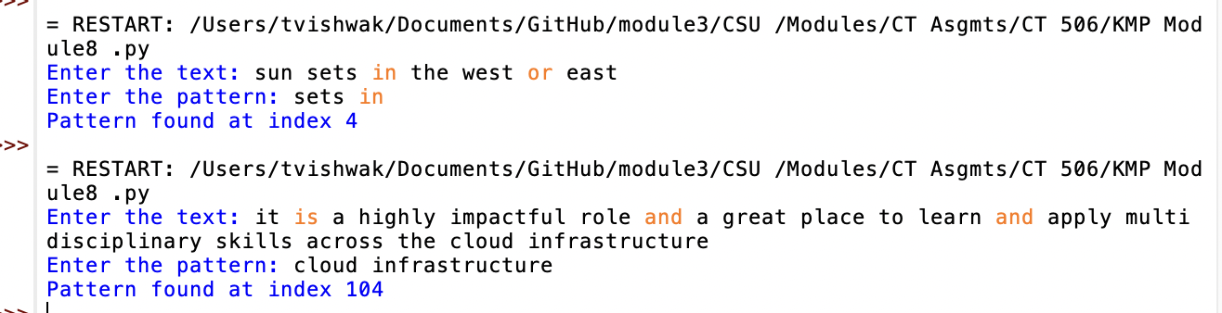
Methodology
1. KMP: Preprocessing using partial match table.
2. Rabin-Karp: Rolling hash for substring matching.
3. Visualization: Highlight matches in text.
4. Performance Testing: Analyze execution times.
Notes:
Algorithm Selection and Design
Knuth-Morris-Pratt (KMP):
This algorithm preprocesses the pattern to create a "partial match" table, which helps to skip unnecessary comparisons during the search process. It is well-suited for scenarios where the pattern remains constant but the input text changes frequently.
Rabin-Karp:
This approach uses a rolling hash function to compute a hash value for the pattern and substrings of the text. It is efficient for searching multiple patterns simultaneously but can result in hash collisions, requiring additional checks.
Implementation Steps
Preprocessing:
KMP: Constructed a partial match table for the pattern.
Rabin-Karp: Defined a hash function for efficient substring matching.
Pattern Search:
Developed functions to scan the input text using the respective algorithms.
Implemented collision resolution for Rabin-Karp to ensure accuracy.
Visualization:
Added functionality to highlight matched patterns within the text.
Designed output tables to compare performance metrics such as time complexity, memory usage, and execution time.
Performance Testing:
Conducted experiments on texts of varying lengths and patterns of different sizes.
Recorded execution times and analyzed the results to identify strengths and weaknesses of each algorithm.

Slide 4
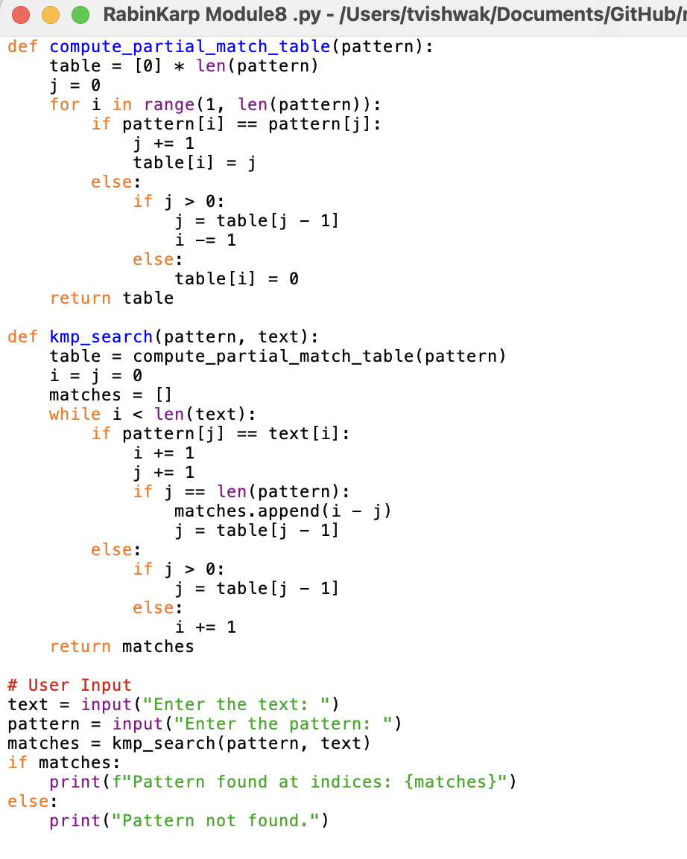
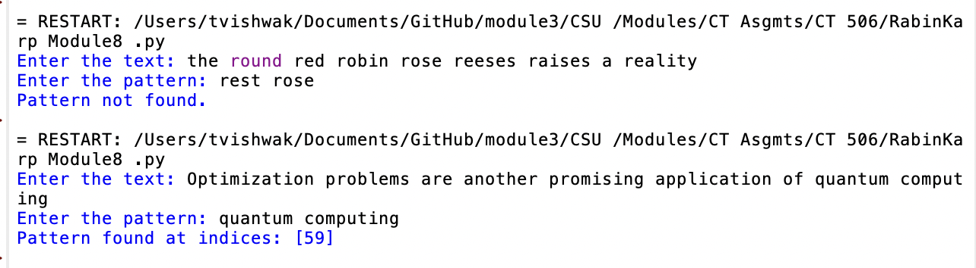
Results
1. Functional pattern matcher with accurate results.
2. Visualization highlights matches effectively.
3. Algorithm Comparison:
- KMP: Consistent for larger texts.
- Rabin-Karp: Faster for smaller patterns.
Notes:
Outcomes
The project successfully met its objectives, producing the following results:
Functional Pattern Matcher:
Both KMP and Rabin-Karp implementations were able to accurately locate patterns in text files.
Visualization Features:
Matched patterns were highlighted effectively, improving user readability.
Algorithm Comparison:
KMP: Demonstrated consistent performance, particularly for longer texts and repetitive patterns.
Rabin-Karp: Performed well for shorter patterns but exhibited slower performance with hash collisions in longer patterns.
Performance Metrics:
Execution time graphs revealed that KMP was faster for larger input sizes, while Rabin-Karp excelled in smaller datasets with minimal hash collisions.

Slide 5
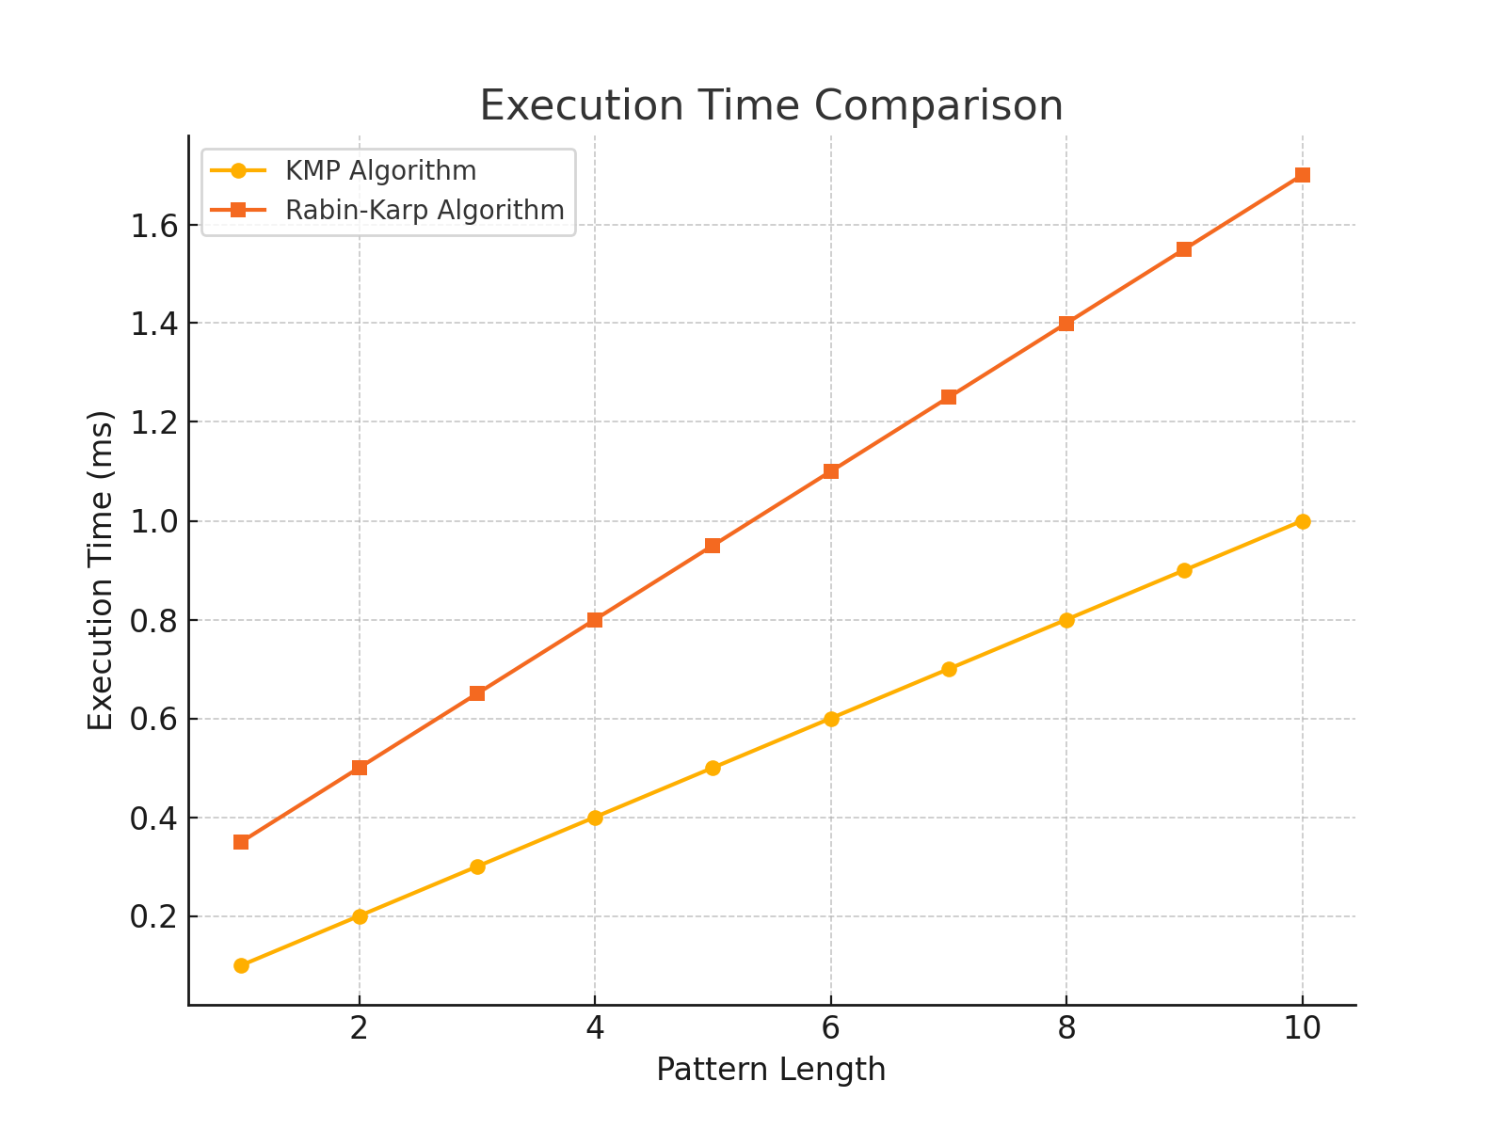
Performance Analysis
1. KMP excels in large input sizes.
2. Rabin-Karp is efficient for small datasets.
3. Graphs show execution time trends.
Notes:
Performance Metrics:
Execution time graphs revealed that KMP was faster for larger input sizes, while Rabin-Karp excelled in smaller datasets with minimal hash collisions.

Slide 6
Challenges
1. Hash collisions in Rabin-Karp.
2. Handling overlapping patterns.
3. Designing user-friendly visualizations.
4. Testing across diverse text files.
Notes:
Obstacles Faced
Hash Collisions in Rabin-Karp:
Addressing false positives caused by hash collisions required additional verification steps, which impacted efficiency.
Pattern Overlap:
Implementing accurate handling of overlapping patterns was challenging, especially in scenarios where patterns repeated frequently.
Visualization Challenges:
Developing an intuitive interface for pattern highlighting required iterative design and testing.
Testing Environment:
Ensuring consistent performance metrics across various text files required setting up controlled testing conditions.

Slide 7
Skills Acquired
1. In-depth understanding of KMP and Rabin-Karp.
2. Efficiency analysis and debugging.
3. Visualization design and implementation.
4. Problem-solving for algorithmic challenges.
Notes:
Skills Acquired
Algorithm Mastery:
Gained in-depth understanding of KMP and Rabin-Karp algorithms, including their preprocessing techniques and performance trade-offs.
Efficiency Analysis:
Developed skills in analyzing algorithmic performance using metrics like time complexity and execution time.
Visualization Techniques:
Enhanced proficiency in creating graphical representations of data and implementing user-friendly highlighting features.
Problem Solving:
Overcame challenges related to hash collisions and overlapping patterns through innovative debugging and testing strategies.

Slide 8
Conclusion
1. Practical insights into KMP and Rabin-Karp applications.
2. Addressed challenges and optimized algorithms.
3. Strong foundation for future text processing projects.
Notes:
The Text Pattern Matcher project provided valuable insights into the practical applications of the KMP and Rabin-Karp algorithms. By overcoming challenges such as hash collisions and designing user-friendly visualizations, the project demonstrated the efficiency and versatility of both algorithms. The results and experiences gained will serve as a strong foundation for future work in text processing and algorithm optimization.

Slide 9
References
Cormen, T. H., Leiserson, C. E., Rivest, R. L., & Stein, C. (2009). Introduction to algorithms (3rd ed.). The MIT Press.
GeeksforGeeks. (2023). Knuth-Morris-Pratt (KMP) algorithm for pattern searching. Retrieved from https://www.geeksforgeeks.org/knuth-morris-pratt-kmp-algorithm-for-pattern-searching/
Gusfield, D. (1997). Algorithms on strings, trees, and sequences: Computer science and computational biology. Cambridge University Press.
Karp, R. M., & Rabin, M. O. (1987). Efficient randomized pattern-matching algorithms. IBM Journal of Research and Development, 31(2), 249-260.
Knuth, D. E., Morris, J. H., & Pratt, V. R. (1977). Fast pattern matching in strings. SIAM Journal on Computing, 6(2), 323-350.

